Slide 1
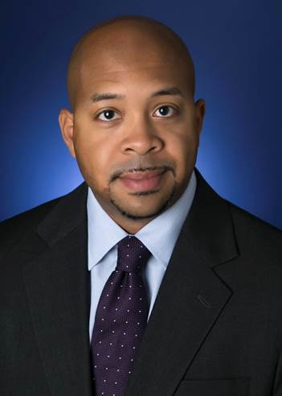
Paul Trussell joined Nike in June of 2021 as VP of Investor Relations and Strategic Finance. In this role, Paul manages relationships with Nike's largest shareholders ensuring that the company’s strategy and financial results are properly communicated. In addition, he is focused on elevating ESG shareholder engagement and connecting Nike’s purpose, strategy and targets to long-term value creation. Previously, Paul served as a Managing Director at Deutsche Bank leading equity research coverage of consumer companies across two verticals: Apparel/Footwear and Grocery. At DB, Paul also served on the Executive Committee of the Americas Region as Diversity Champion and was co-founder and co-chair of the Black Leadership Forum Employee Resource Group. Paul is a Chartered Financial Analyst (CFA) and holds a bachelor’s degree in finance from the University of Illinois at Urbana-Champaign.

